Slide 1

Healthcare Data Insights Dashboard
An Analytical Study on Patient Demographics, Billing Patterns & Hospital Efficiency
By Rupnath Shaw

Slide 2


Project Overview
Objective
Methodology
Uncover patterns in billing, demographics, and stay duration
Data cleaning → Pivot analysis → Dashboard visualization
Tools
Dataset
Excel: Power Query, Pivot Tables, Charts, Slicers
55,500 records across 15 fields

Slide 3







Data Cleaning Process
Remove Duplicates
✅ Result
Eliminated null values and duplicate entries
Clean, analysis-ready dataset prepared for comprehensive insights
Standardize Text
Unified Name, Doctor, Hospital fields
Format Dates
Converted to proper Date format
Calculate Duration
Stay Duration = Discharge - Admission
Filter Invalid Data
Removed invalid hospital entries

Slide 4

Patient Demographics Analysis
O+
A+
50/50
Most Common
Second Most
Gender Balance
O+ blood type leads patient distribution
A+ follows closely in frequency
Equal distribution across blood groups
Key Recommendation
Maintain balanced blood inventory for O+ and A+ groups to meet demand

Slide 5
Billing Summary Insights
Emergency Cases
Obesity
Diabetes
Higher billing across all conditions
Leads to highest treatment costs
Second highest cost driver
💡 Recommendation
Optimize emergency care billing and improve preventive care for obesity and diabetes

Slide 6

Insurance Provider Analysis
Blue Cross
Highest billing coverage across medical conditions
Medicare
Second highest coverage for expensive treatments
Negotiate better reimbursement terms with Blue Cross and Medicare for cost control

Slide 7


Stay Duration Analysis
16
Average Days
Typical patient stay duration
Female Patients
Recommendation
Slightly longer stays in Cancer and Obesity cases
Implement post-care programs to reduce duration without compromising quality

Slide 8


Test Results Analysis
Diabetes
Hypertension
Frequent abnormal test results detected
High incidence of abnormal readings
Early Detection
Critical for high-risk conditions
Strategic Recommendation
Strengthen early diagnostic programs for high-risk conditions like Diabetes

Slide 9

Dashboard Overview
55.5K
₹25.5K
16
Total Patients
Avg Billing
Avg Stay (Days)
Key Insights
Recommendations
Obesity & Diabetes drive billing costs
Focus on chronic disease prevention
Emergency cases = highest treatment cost
Streamline emergency admission costs
Blue Cross & Medicare handle expensive treatments
Align insurance reimbursement strategies
Balanced gender & blood type distribution
Maintain blood supply diversity

Slide 10
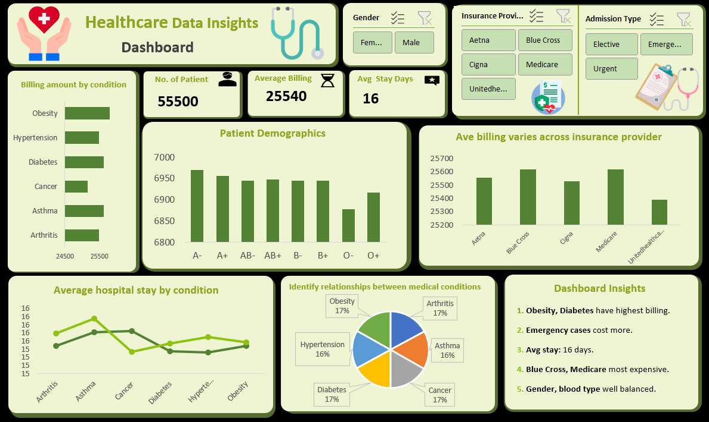
Dashboard

Slide 11

Conclusion
Data-Driven Insights
Decision-Making
Improve hospital cost management and care efficiency
Enable strategic choices on admissions, insurance, and patient care
Future Scope
Integrate Power BI for automated reporting and deeper time-based trends

